Slide 1
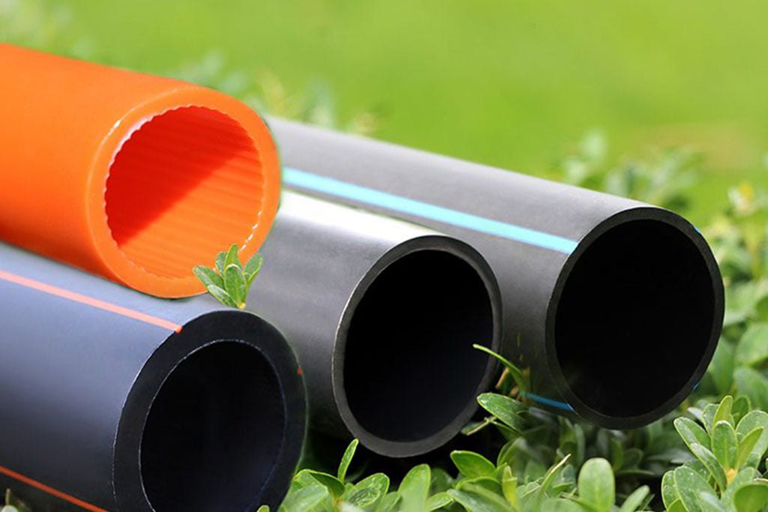
Infrastructure development begins with a pipe — we lay the groundwork for recovery.
Presentation
LLC TD Bur Leasing
Setting Up a Polyethylene Pipe Production Plant
PROJECT GOAL
Promoting the development of domestic industry through the creation of an efficient processing facility for the production of polyethylene pipes and fittings that meet modern standards and ensure reliability and durability in construction and utility installation, supporting Ukraine's infrastructure recovery and export to the EU.

Slide 2
About Company
Company Presentation
Bur Leasing Trading House LLC specializes in supplying high-quality raw materials for polyethylene pipe manufacturers, as well as selling polyethylene pipes and fittings, and has significant experience in this industry
Raw materials
Business Model
Proprietary solution
○ The company's core product is recycled polyethylene and polypropylene, which includes collected and sorted polyethylene that undergoes crushing, washing, and processing into granules.
○ Finished products - technical pipes used in mines and quarries.
○ Supply of raw materials, manufacturing and sales of polyethylene pipes and fittings.
○ We provide raw materials to factories and only pay for the processing service.
○ As a result, we get finished products that we sell to end consumers.
○ Thanks to close collaboration with clients who operate pipes in extreme conditions (slurry, rock materials), we have developed three-layer pipes with enhanced wear resistance, extending service life by 4–5 times.

Slide 3
Company Presentation
Our Achievements
Dynamic growth
Stable market position
○ We increased polyethylene sales from 2–3 truckloads per year → to 10 truckloads per month.
○ Turnover grew 11 times:
2022 — UAH 1.7 million → 2023 — UAH 18.9 million
○ Client base with regular orders
○ Products are pre-booked — reflecting demand and trust
○ Established production partnerships
○ Experience and understanding of polyethylene quality and technical properties, which enables us to select the best offers on the market
Innovation solution
Technological adaptability
Scalability readiness
Three-layer polyethylene pipes developed for extreme operating conditions
○ Service life extended 4–5 times thanks to a specialized design
○ The solution is proven in mines, quarries, and slurry pipelines
○ We actively implement innovations and stay up to date with the latest industry trends.
○ We monitor developments not only in raw materials, but also in equipment for both material and pipe production.
○ Own Raw Material
○ BaseProven business model
○ Stable cash flows enabling reinvestment into production

Slide 4
Company Presentation
Product & Technology
Core products
Key features
Strategic Advantages
65%
○ Supply of recycled polyethylene and polypropylene
○ Polyethylene pipes
○ Recycled raw materials – a stable, eco-friendly, and cost-effective solution
○ Three-layer pipes – extended service life by 4–5 times
○ Increased durability and strength for extreme conditions (slurry, rock, mining)
○ Compliance with DSTU / EN standards, quality control at every stage
○ Products tailored to specific industry needs (mining, utilities, agriculture)
○ Fast delivery with no import dependencyLower cost through localization and in-house raw materials
○ Eco-friendliness — use of recycled plastic

Slide 5
Market Analysis
Company Presentation
Problem
Cause
Consequences
○ Destruction of production facilities due to the war (approximately 50% of the market has disappeared).
○ Some factories are located in occupied territories or active combat zones.
○Outdated technologies among competitors (low product durability)
○ Delays in the implementation of infrastructure, construction, and agricultural projects.
○ Increased costs due to import dependence and logistics.
○ Slower recovery rates and budget losses.
Shortage of high-quality polyethylene pipes
○ Logistics challenges.
○ High costs (customs duties, currency risks).
○ Shortage of finished products in the EU due to internal demand.
○ Supply instability.
○ Risk of deadline disruptions.
○ Decreased availability of materials for key sectors.
Dependence on imports
○ Logistics challenges.
○ High costs (customs duties, currency risks).
○ Shortage of finished products in the EU due to internal demand.
○ Farmers are unable to expand irrigation.
○ Construction companies cannot complete projects.
○ Utility networks are not being upgraded.
Product shortage in agriculture, housing, and industry

Slide 6
Company Presentation
Solution & Result
◊ Response to market demand — launching our own production
We are establishing a modern polyethylene pipe manufacturing facility in Ukraine to:
• fill the gap in the domestic supply market
• reduce dependence on imports
• provide key economic sectors with high-quality and affordable products..
◊ The project includes:
• Establishing In-House Production
• Automated extrusion line for polyethylene pipes
In-house raw material base: recycling of secondary polyethylene and polypropylene
• Production of three-layer wear-resistant pipes for mining, utilities, and agriculture
• Localized manufacturing — fast delivery without import risks
◊ Increased Import of Raw Materials to Ukraine
• In addition to supplying our own production, we are considering expanding the supply of recycled polyethylene and polypropylene for sale to other manufacturers.
This will help partially address the raw material the raw material shortage on the market and strengthen local production chains.
◊ Result:
• Supplying the Ukrainian market with domestically produced polyethylene pipes
• Opportunity to enter export markets in EU countries
• Addressing the domestic shortage of recycled raw materials — through import and resale to other manufacture
• Strengthening local production chains and reducing the industry's overall import dependence

Slide 7
Company Presentation
Market and Target Audience
Market
Market Potential
Target Audience
Customer Base
• Ukraine is the primary market: construction, utilities, agriculture, and mining sectors
• Export markets: Poland, Moldova, Romania — countries with high demand for pipe products and close logistical proximity
• Over 20,000 projects have already been registered for construction and reconstruction since the start of the war
• Demand for pipes is increasing as part of infrastructure recovery
• Import substitution opens a niche for domestic producers.
• Construction companies
• Municipal utilities and public service providers
• Agricultural enterprises
• Mining companies
• Regional administrations, communities, and military-civil administrations (MCAs)
• An established network of B2B clients across Ukraine.
• Some clients place orders in advance — confirming stable demand.
• There is interest from buyers in localizing production.

Slide 8
Investment Scenarios
Company Presentation
1. Greenfield production | Purchase of equipment, lease of premises with adjacent territory | $ 8 million | Equity / share / joint venture | Full control, high level of automation, modern model | 9-month payback | ROI: 16%
2. Expansion based on an existing plant | Partnership with an operating plant with insufficient capacity, and purchase of additional equipment for expansion | $ 8 million | Joint Venture / contribution to development | Fast launch, reduced CAPEX, existing infrastructure | 9-month payback | ROI: 16%
3. Purchase of a non-operational factory | Acquisition of a bankrupt plant, modernization, and relaunch | $ 8 million | Asset buyouts / strategic partnerships | Ready-made infrastructure at lower cost, fast start | 9-month payback | ROI: 16%
Scenario
Essence
Investment
Participation Model
Advantage
Payback / ROI

Slide 9
Project Investment Budget
Company Presentation
Budget Item | Cost $ | Investor $ | Project Initiator$ | Total $
1. Line 20–110 mm diameter | 250 000,00 | 25 000,00 | - | 250 000,00
2. Line 110-315 mm diameter | 350 000,00 | 350 000,00 | - | 350 000,00
3. Line 280-630 mm diameter | 600 000,00 | 600 000,00 | - | 600 000,00
4. Line 500 - 1200 mm diameter | 1 300 000,00 | 1 300 000,00 | - | 1 300 000,00
5. Raw materials | 3 000 000,00 | 3 000 000 | - | 3 000 000,00
6. Installation and site preparation | - | - | 1 500 000,00 | 1 500 000,00
7. Operating and current expenses | - | - | 1 000 000,00 | 1 000 000,00
Total: |  | 5 500 000,00 | 2 500 000,00 | 8 000 000,00
Share (%) |  | 68,8% | 31,3%
Durable

Slide 10
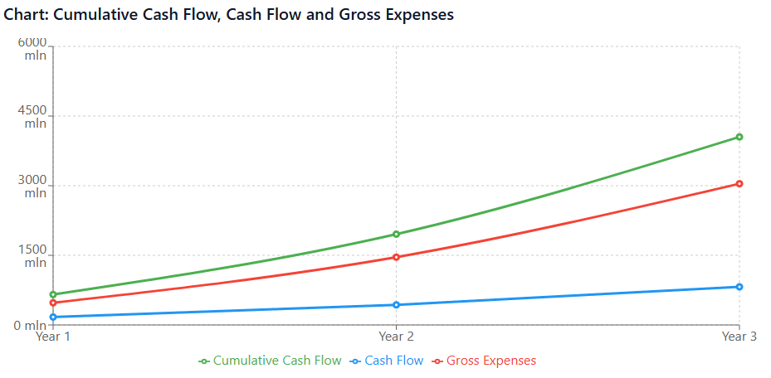
Projected Financial Dynamics of the Project (Years 1–3)

Slide 11
Company Presentation
SWOT Analysis
○ Availability of own imported products — a stable foundation for launching and developing production
○ Use of recycled raw materials — economically and environmentally beneficial
○ Established customer base and demand for technical pipes
○ Import substitution with a locally produced product
○ Ukraine's infrastructure recovery — growing demand for pipes for utilities, water supply, and agriculture
○ Expansion to EU markets with high-quality products and competitive pricing
S
O
○ Significant initial investments in construction, equipment, and logistics
○ Risks of raw material delays due to logistics, currency fluctuations, and customs barriers
○ Pipe production is energy-intensive, especially during raw material processing
○ Economic instability, currency fluctuations, and changes in energy prices
○ Competition from market players with greater resources
○ Regulatory changes, demand fluctuations, and payment delays may complicate operations
W
T

Slide 12
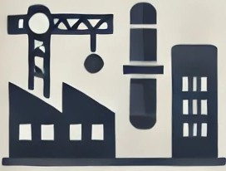
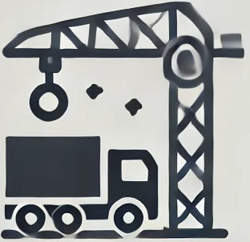
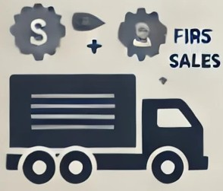
Project Roadmap
Company Presentation
Preparation and legal formalities
Construction and installation works
Equipment delivery and installation
Staff recruitment and training
Launch and
initial sales
● Preparation of the production site or facility
●Legal formalities for the purchase of equipment, land, or assets
●Renovation/reconstruction, infrastructure installation
● Utility connections
● Delivery and installation of production lines
● Line configuration according to product specifications
● Administrative staff – 24 people
● Production staff – 65 people
● Start of sales in the domestic market
● Preparation for scaling and expansion into new regions

Slide 13
Project Team
Director of the LLC
He manages the project based on his diverse experience and three higher education degrees: a Master's in Public Finance Management, a Bachelor's in Law, and a qualification in Practical Psychology. He has extensive experience in the banking sector, state investment companies, and pipe manufacturing, which ensures a comprehensive approach to business management. His expertise in analyzing projects for SMEs and VIP clients enables well-informed decision-making, while his skills in attracting financing contribute to successful investor relations. His leadership qualities and ability to organize quality control ensure team productivity and client trust
Бухгалтер
Юридична підтримка
A Master of Finance with over 12 years of experience as a chief accountant. Previously worked at the tax inspection office in the audit department and held senior positions in manufacturing and trading companies. Participated in joint projects with the Deposit Guarantee Fund, highlighting her expertise in financial reporting and auditing.
Experienced legal professionals who support large businesses, including financial companies. They collaborate with the National Bank of Ukraine and the Association of Ukrainian Banks, ensuring professional legal support and full compliance of the project with applicable legislationі.

Slide 14
Marketing Strategy
Company Presentation
Online promotion
○ Regular website updates
○ Social media activity (TikTok, Facebook, Instagram, Telegram, LinkedIn)
Offline advertising
Industry events
○ Regular participation in exhibitions and conferences
○ Establishing B2B connections through personal presentations
○ Publications in industry-specific media
○ Distribution of flyers in construction stores, offices, and at events

Slide 15
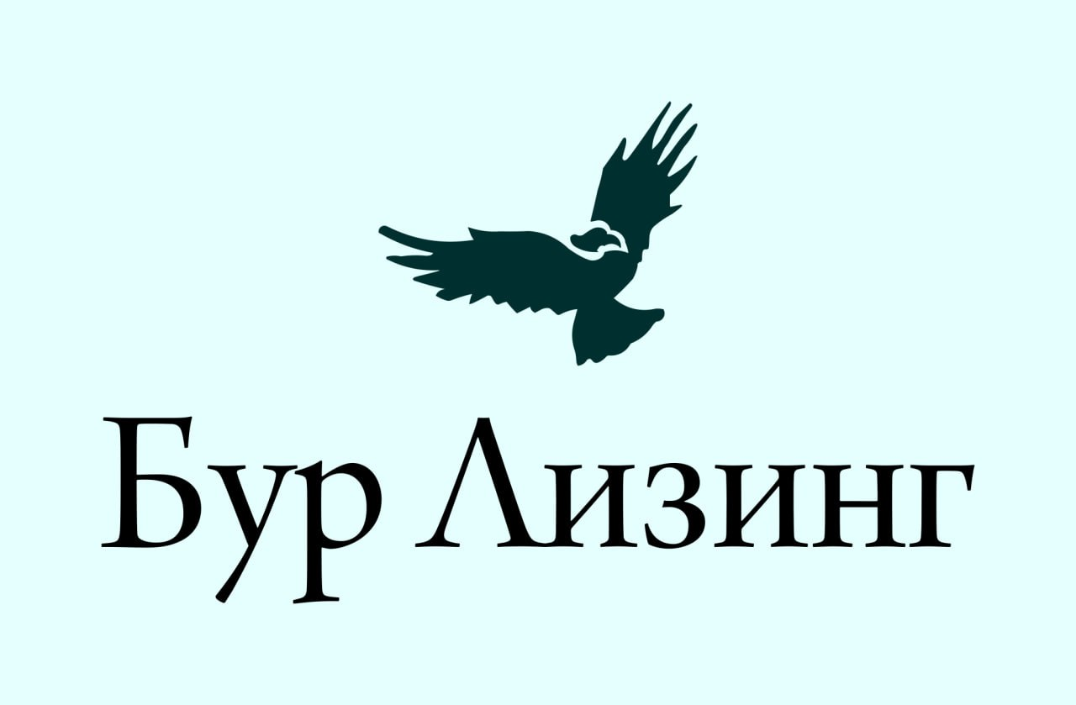
Company Presentation
Thank you
For your attention
https://burleasing.com
vk@burleasing.com
+380674053870– Viktor Khomenko

